Slide 1
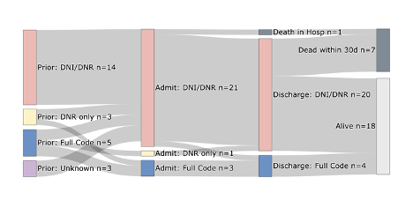

Slide 2
Common Methods of Identifying Hypercapnic Respiratory Failure Produce Meaningfully Different Cohorts Brian Locke, Krishna Sundar, Jeanette Brown, Ramikiran Gouripeddi
Changes in Bicarbonate in Patients at Risk for Obesity Hypoventilation Undergoing Bariatric Surgery Brian Locke, Conrad Addison, Somya Mishra, Krishna Sundar

Slide 3

Common Methods of Identifying Hypercapnic Respiratory Failure Produce Meaningfully Different Cohorts Brian Locke, Krishna Sundar, Jeanette Brown, Ramikiran Gouripeddi
30d Readmission rate: 23% (2/3 recurrence)
~=CHF. > than MI, AECOPD, PNa
Admitted (ICU or floor) with one of the following diagnostic codes:
J96.02 (acute hypercapnic respiratory failure)
J96.22 (acute and chronic respiratory failure with hypercapnia)
J96.92 (respiratory failure unspecified with hypercapnia)
J96.12 (chronic respiratory failure with hypercapnia)
E66.2 (morbid obesity with hypoventilation)
Admitted to hospital (Floor or ICU) with ABG showing PaCO2 over 45 mmHg and pH 7.35-7.45
 | COPD (2/3) | No COPD (1/3)
AHI Median [IQR] | 31.9 [14.3, 45.6] | 66.0 [48.0, 83.8]
AHI > 5 present | 66% | 94%
AHI > 15 present | 51% | 81%
ABG PaCO2 > 45 mmHg w/n 24h of admission; exclude iatrogenic, arrest…
1. Admitted to the ICU
2. PaCO2 greater than 47.25 mmHg
3. Procedure code for non-invasive ventilation or invasive mechanical ventilation initiation
163 hospitalizations with hypercapnia per 100,000 person-years. (Roughly the same as PE)
Notes:
Exclusion of other causes of hypoventilation
Obesity -> increased CO2 production and vent limitation from mass of chest wall and disadvantaged respiratory mechanics
“Other Causes”: Obstructive lung disease, neuromuscular / chest wall disease, things that suppress ventilatory drive (opiates), or causes of metabolic alkalosis (loop diuretics)
Likely routine to you all, but this is often botched in pulmonary and inpatient medicine.
Exclusion parameter
In research studies: A patient with mild COPD cannot have OHS. In reality – what do you do with a patient who has COPD so mild that it doesn’t cause OHS? Or, if it’s mild enough that it wouldn’t cause hypercapnia on it’s own? Open questions, problem with the paradigm.
“Exclusion of other causes of hypoventilation
Severe obstructive respiratory disease
Severe interstitial lung disease
Severe chest-wall disorders (eg, kyphoscoliosis)
Severe hypothyroidism
Neuromuscular disease
Congenital hypoventilation syndromes”

Slide 4
Common Methods of Identifying Hypercapnic Respiratory Failure Produce Meaningfully Different Cohorts Brian Locke, Krishna Sundar, Jeanette Brown, Ramikiran Gouripeddi
69 Million MRNs aggregated from 50 academic medical centers
Deidentified patient level data, including admissions, diagnoses, medications, procedures, and lab values.
Missing data?
Hypothesis 1: The methods used in prior studies of hypercapnic respiratory failure (billing code-, procedural code-, and blood-gas-based criteria) identify different patients.
Outcome: Relative Sensitivity; Positive Predictive Agreement
Hypothesis 2: The cohorts created by these differ methods differ in risk for outcomes of interest, which hampers interpretation of these studies.
Outcome: distribution of age, ethnicity, BMI, and frequency of coexisting diagnoses (OSA, opiate use disorder, COPD, CHF, and neuromuscular disease)
Notes:
Exclusion of other causes of hypoventilation
Obesity -> increased CO2 production and vent limitation from mass of chest wall and disadvantaged respiratory mechanics
“Other Causes”: Obstructive lung disease, neuromuscular / chest wall disease, things that suppress ventilatory drive (opiates), or causes of metabolic alkalosis (loop diuretics)
Likely routine to you all, but this is often botched in pulmonary and inpatient medicine.
Exclusion parameter
In research studies: A patient with mild COPD cannot have OHS. In reality – what do you do with a patient who has COPD so mild that it doesn’t cause OHS? Or, if it’s mild enough that it wouldn’t cause hypercapnia on it’s own? Open questions, problem with the paradigm.
“Exclusion of other causes of hypoventilation
Severe obstructive respiratory disease
Severe interstitial lung disease
Severe chest-wall disorders (eg, kyphoscoliosis)
Severe hypothyroidism
Neuromuscular disease
Congenital hypoventilation syndromes”

Slide 5
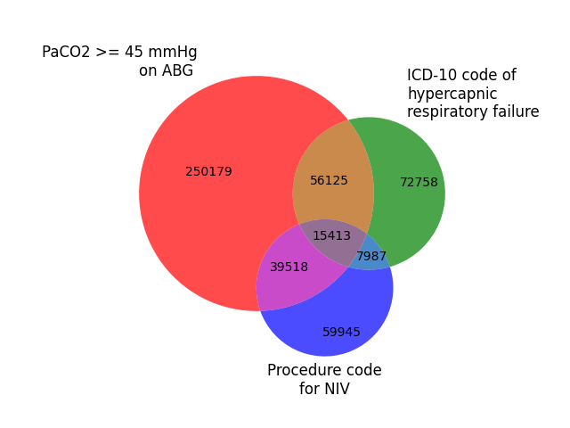
Common Methods of Identifying Hypercapnic Respiratory Failure Produce Meaningfully Different Cohorts Brian Locke, Krishna Sundar, Jeanette Brown, Ramikiran Gouripeddi
Preliminary Results
ICD Group:
Relative sensitivity (vs ABG): 19.8%
Positive Predictive Agreement (vs ABG): 47.0%
NIV Group:
Relative sensitivity (vs ABG): 15.2%
Positive Predictive Agreement (vs ABG): 45.2%
Notes:
Why start with inpatients with Hypercapnia?
Easier ascertainment
Informed presence bias
Labs
Data sources
Higher morbidity

Slide 6
Common Methods of Identifying Hypercapnic Respiratory Failure Produce Meaningfully Different Cohorts Brian Locke, Krishna Sundar, Jeanette Brown, Ramikiran Gouripeddi
 | ABG Group | ICD Group | NIV Group
Age | 62±18 | 65±16 | 62±17
% Female | 46% | 51% | 42%
% white | 66% | 71% | 65%
% Black | 18% | 19% | 17%
BMI | 30.4±8.3 | 33.1±10.3 | 29.1±8.2
% with CHF | 37% | 30% | 19%
% with COPD | 31% | 30% | 14%
% Opiate UD | 6% | 3% | 3%
% Sleep Apnea | 23% | 24% | 10%
Remaining Analyses:
Stratification by time of ABG
Data integrity checks:
Require each type of info from source during admission
Sensitivity analysis among patients with all 3 data-types

Slide 7
Common Methods of Identifying Hypercapnic Respiratory Failure Produce Meaningfully Different Cohorts Brian Locke, Krishna Sundar, Jeanette Brown, Ramikiran Gouripeddi
For accurate determination of
Frequency of different comorbidities or component causes
Morbidity and mortality associated with hypercapnia
Who should be included in future studies to determine frequency benefit from treatment
... method of patient identification likely matters
Interpretability of current research could be improved using standard case definitions (EHR Phenotype)
How should we identify these patients for studies?
ATS ASPIRE grant

Slide 8
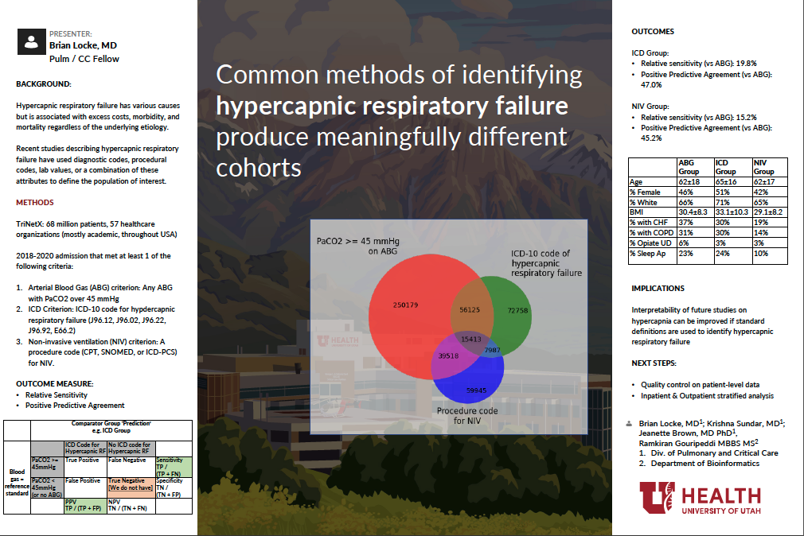

Studies of hypercapnic respiratory failure using various definitions
Notes:
Normal bicarbonate range should be: 23-30 Meq/L
https://cjasn.asnjournals.org/content/13/2/343
Normal elevation correction: per 1000m, 1.5 mEq/L lower

Slide 9
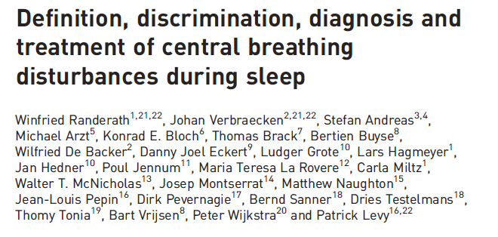
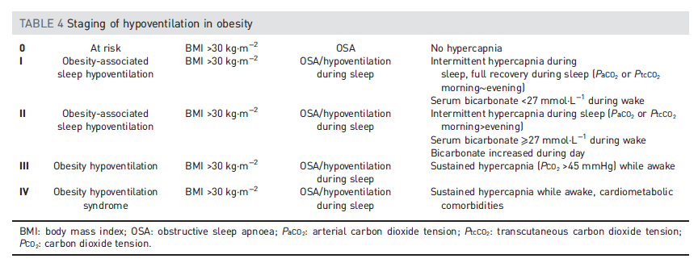
Changes in Bicarbonate in Patients at Risk for Obesity Hypoventilation Undergoing Bariatric Surgery Brian Locke, Conrad Addison, Somya Mishra, Krishna Sundar
ERS 2018: Obesity-related hypoventilation paradigm
Notes:
Exclusion of other causes of hypoventilation
Obesity -> increased CO2 production and vent limitation from mass of chest wall and disadvantaged respiratory mechanics
“Other Causes”: Obstructive lung disease, neuromuscular / chest wall disease, things that suppress ventilatory drive (opiates), or causes of metabolic alkalosis (loop diuretics)
Likely routine to you all, but this is often botched in pulmonary and inpatient medicine.
Exclusion parameter
In research studies: A patient with mild COPD cannot have OHS. In reality – what do you do with a patient who has COPD so mild that it doesn’t cause OHS? Or, if it’s mild enough that it wouldn’t cause hypercapnia on it’s own? Open questions, problem with the paradigm.
“Exclusion of other causes of hypoventilation
Severe obstructive respiratory disease
Severe interstitial lung disease
Severe chest-wall disorders (eg, kyphoscoliosis)
Severe hypothyroidism
Neuromuscular disease
Congenital hypoventilation syndromes”

Slide 10
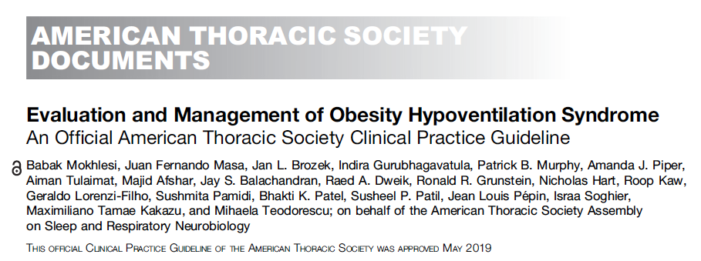
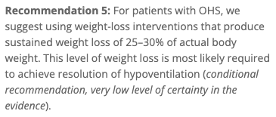
Changes in Bicarbonate in Patients at Risk for Obesity Hypoventilation Undergoing Bariatric Surgery Brian Locke, Conrad Addison, Somya Mishra, Krishna Sundar
Hypothesis 1: [HCO3-] has low enough biologic variation to functional usable surrogate for nocturnal CO2 retention peri-bariatric surgery
Outcome: intra-patient variability in measurement, frequency of metabolic disturbances
Hypothesis 2: Δ[HCO3-] has construct validity as an index of response to interventions that decrease nocturnal CO2 loading
Δ[HCO3-] will be higher in patients who lose more weight, who start and adhere to CPAP.

Slide 11
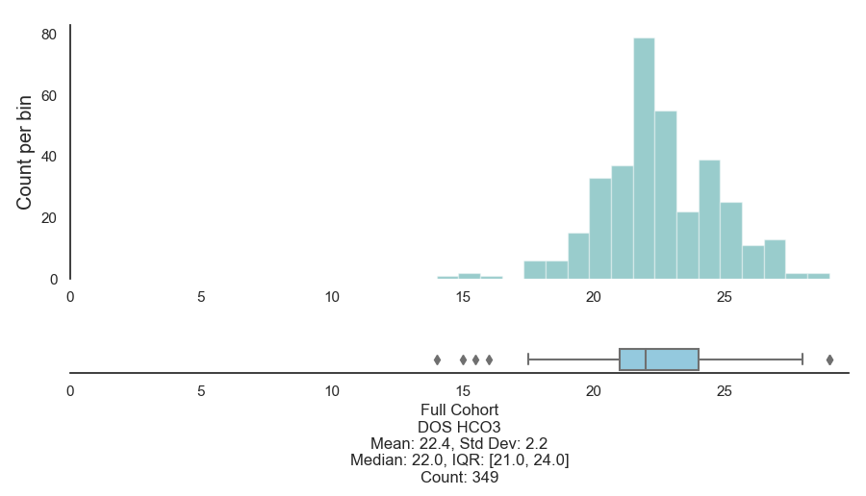
Changes in Bicarbonate in Patients at Risk for Obesity Hypoventilation Undergoing Bariatric Surgery Brian Locke, Conrad Addison, Somya Mishra, Krishna Sundar
Patients: n=359 patients who underwent bariatric surgery (mostly bypass) 2011-2016 at U of U
Exposures: time of OSA dx, CPAP use, Maximum weight loss
Outcome: Change in 6-mo, 1-yr, 2-yr [HCO3-]
[HCO3-] – day of surgery
Other analyses:
% of patients meeting ERS II or higher OHS
% Excluded due to metabolic process
Notes:
Cleveland Clinic; universal etCO2 before bariatric surgery
Prevalence: 68.4% by EtCO2 > 45 or HCO3 over 27.
Bariatric surgery screening for OHS:
Tran, Wang, Gharaibeh, et al.: Bariatric Surgery Risk in Obesity Hypoventilation - A total of 1,718 patients undergoing polysomnography with end-tidal CO2 monitoring prior to bariatric surgery at Cleveland Clinic from September 2011 to September 2018 were included.”
Key Findings: “OHS prevalence was 68.4%. Unadjusted analyses revealed a 1.5% increased odds of OHS (1.01; 1.00-1.03) per 1-unit BMI increase, 1.7% (1.02; 1.01-1.02) per 1% increase in sleep time Sa_{O2} < 90%, 12% increase (1.12; 1.03-1.22) per 1-U increase in hemoglobin A1c, and 3.4% increased odds (1.03; 1.02-1.05) per 5-U increase in apnea-hypopnea index. The association of apnea-hypopnea index with OHS persisted after adjustment for age, sex, race, and BMI and its comorbidities (1.02; 1.01-1.04)”
“In a single-center retrospective study of morbidly obese patients admitted to the intensive care unit because of hypercapnic respiratory failure due to obesity hypoventilation, 75% had been erroneously diagnosed and treated for COPD, and 86% were being treated for congestive heart failure (36).”
“Marik and Desai reported that 8% of all admissions to a general ICU with acute-on-chronic hypercapnic respiratory failure met diagnostic criteria for OHS (22). “
Marik PE, Desai H. Characteristics of patients with the “malignant obesity hypoventilation syndrome” admitted to an ICU. J Intensive Care Med 2013;28:124–130.
BMI over 50+ - high rates
The CDC estimated that 7.6% of the adult U.S. population has a BMI ≥40 kg/m² (https://pubmed.ncbi.nlm.nih.gov/29922829/).

Slide 12
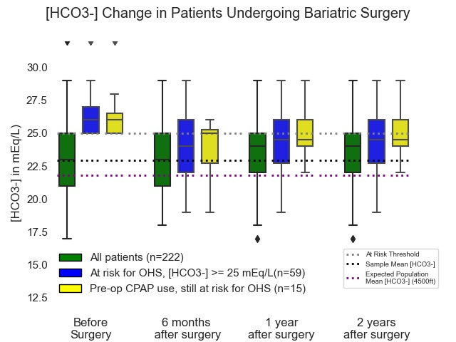
Changes in Bicarbonate in Patients at Risk for Obesity Hypoventilation Undergoing Bariatric Surgery Brian Locke, Conrad Addison, Somya Mishra, Krishna Sundar
Exclusions:
(n=32,27 w/o pre-, post- data)
n=15 on diuretic
n=20 on topiramate
n= 24 on chronic opiates*
n=9 on other med
n=9 sCr over 1.3
26% have reason to expect
59 of 222 (26.6%) patients with ERS 2+ OHS
Weight loss = Nadir at 12 months then weight regain [median 5kg]
No HCO3 ‘regain’
Regression to the mean

Slide 13
Changes in Bicarbonate in Patients at Risk for Obesity Hypoventilation Undergoing Bariatric Surgery Brian Locke, Conrad Addison, Somya Mishra, Krishna Sundar
Proposed re-analysis:
Missing data: multiple imputation with chained equations
What proportion of variability of [HCO₃⁻] is inter-vs-intra person? Intraclass correlation coefficient
Multilevel (mixed effect) regression model of [HCO₃⁻] with predictor variables: starting [HCO₃⁻], OSA severity (or diagnosis), CPAP adherence, weight loss
Outputs = continuous; loses interpretability of dichotomization
Parallel Coordinate plot (e.g. at side)

Slide 14
